Slide 1
A Brave New World for us
Gender Dysphoria

Slide 2
Gender Dysphoria
Metta – the Oxford dictionary says that the word comes from an ancient Indian language and means “loving-kindness”.
And the Metta Clinic

Slide 3
Objectives
1. To better understand the sexual and gender
continuums
2. To increase knowledge of the gender transition process
3. How to relate to this population in your nursing practice

Slide 5
LGBTQ
Lesbian
Gay
Bisexual
Transgender
Queer (fluidity of gender expression)

Slide 6
Definition
“Individuals with gender dysphoria have a marked incongruence between the gender they have been assigned at birth and their experienced/expressed gender.”
American Psychiatric Association: Diagnostic and statistical manual of mental disorders, fifth edition. Arlington, VA, APA, 2013.

Slide 8
persisters
Prepubertal – few studies
* 6-23% of children presenting
with gender dysphoria persist
into adulthood
Adolescence – most presenting with gender dysphoria persist into adulthood
International Journal of Transgenderism: seventh version of the Standards of Care, 13(4), 165-232. doi:10.1080/15532739.2011.700873
Notes:
Few studies have been done around gender dysphoria in prepubertal children. Results of the few studies that have been done demonstrate that 6-23 of children presenting with gender dysphoria persist into adulthood. Those that don’t persist - known as desisters – go on to identify as gay , lesbian or heterosexual in adulthood.
In contrast, research shows that most adolescents who present with gender dysphoria, persist into adulthood.

Slide 9
Emerging Population in Calgary
Pooled research from US estimates 0.3% prevalence in adults
In Alberta – 12,000
In Calgary – 3600
In Metta clinic –2015- 80
- 2016- 137
- now a two and ½ year wait list for an
initial assessment
Gates, G. (2011). How many people are lesbian, gay, bisexual, and transgender? (Research Brief) (p. 8). Los Angeles, CA: The Williams Institute, ULCA School of Law.
Notes:
Results from research from the US estimated a 0.3% prevalence of gender dysphoria in adults. If we applied those results to Alberta residents, it would translate to 12,000 Albertans, 3600 of those from Calgary.

Slide 10
Interventions
First step: Puberty suppressors- will have been assessed or planned to be assessed by a Mental Heath professional specializing in gender issues
Ideally given at first signs of puberty
Reversible
Signed consent
Medication: Lupron Depot
*monthly or 3 monthly IM injection
*cost approx. $500.00/injection (monthly)

Slide 11
Interventions
Second step: Cross Hormones- requires a formal diagnosis of gender dysphoria
Usual age around 16 years old
Irreversible
Signed consent
Medication: Testosterone (injection, patch or gel)
Estrogen (pills or patch)

Slide 12
FTM - Testosterone
Within 6 months of starting:
Cessation of menses
Deepening of voice
Facial/body hair growth
Increased muscle mass
Clitoral enlargement

Slide 14
MTF – Estrogen
Within 6 months of starting
Breast growth
Decrease in muscle mass
Softening of skin
NO voice changes
NO scalp hair regrowth

Slide 16
interventions
Third step: Surgeries
17 years and older
Irreversible
Signed consent
Some may not go to this

Slide 17
FTM - Surgery
Top surgery – mastectomy
Bottom surgery – neopenis (in Montreal)
- removal of ovaries,vagina
and uterus
- 20-25 per year are funded by the Alberta Government

Slide 18
MTF - Surgery
Top surgery – breast augmentation
Bottom surgery – gonadectomy, penectomy,
creation of vagina
Other:
Voice therapy to change pitch of voice
Electrolysis or laser for unwanted hair

Slide 19
Introduction of our Special Guests
We are pleased to introduce Ace and his mom Lindsay

Slide 20
challenges – Health Care Related
Name Change/Gender Marker change/label change – cost (≈ 300$), process (registry office and vital statistics forms), time ≈ (5 months)
In patient – communication
Outpatient – wait list time
Surgical wait time – bilateral mastectomy and male chest contouring
Notes:
These are some of the challenges youth and families have shared with us that they have encountered within the health care system. I wonder, Ace and Lindsay, if you can speak to any of these.
Before the hospital information can be changed to reflect her preferred name and gender, it needs to have been done legally. It is quite a process and if someone is under the age of 18 it actually has to be her parents that apply. For a legal name change for a minor the process includes: parental consent, registry office forms filled out, a set of electronic fingerprints taken if older than 12 – finding out where to go to have these taken at a cost of around 50$ - the process takes around 5 months. The old birth certificate is cancelled and a new one issued. Cost is around 250$ plus the cost of the fingerprints. For gender marker change, an amendment to Vital Statistics is required. Turn around time to receive the package with the information about how to proceed takes 3- 5 months. Cost is only 20$ though.
Communication between health care providers is another challenge – how can you possibly let everyone know this youths preference if the legal name change has not happened? Lab, x-ray, nurses, doctors, unit clerks, aides,….the list goes on and on.
Another challenge that has been identified is the time it takes to be assessed and leading on from that, treated. Many of these youth want hormone treatment now if not yesterday. With the waitlist being what it is, this is not happening as quickly as some would like. Starting the process is a way for these youth to feel heard. For them it is often about hope.
We have only recently been in discussions with the plastic surgeons trying to

Slide 21
Health Care related
What things have been helpful along this journey?
What things have not been helpful along this journey?

Slide 22
challenges– SCHOOL
Name Change/Gender marker Change
Sports Teams
Change Rooms/Bathrooms
Bullying
Social Transition
Notes:
It is not difficult for parents to change their child's name or gender at the school level – however, to change the official school record the legal process as in the previous slide has to be followed.
You might think of school sports teams as a challenge but last year the Alberta Athletic Association passed a policy that allowed transgendered individuals to participate on the sport team that aligned with their lived gender identity. Complaints have been filed but no problems have arisen thus far. Alberta is the 4th province to have such a policy – behind Ontario, Manitoba and BC.
In Calgary only 15% of transgendered youth use the bathroom/change room of their preferred gender – individual stalls are preferred by most.
Bullying in any form is not tolerated in the school system and there are policies in place to deal with it.
Social relationships may already be a struggle for some adolescents. Added in to that is the transitioning to another gender. School personal are sitting down with each person who is transitioning to try to figure out how it happens best for each person – that stress is unique to each person.

Slide 23
Challenges - Community
Public Bathrooms – carry letter
Notes:
Physicians write letters that transgendered people carry that if challenged they can produce to show that they should be treated as a person of their preferred gender.

Slide 24
Resources
Calgary Sexual Health Centre – 403-283-5580
Trans Lifeline – 1-877-330-6366
ACH Metta Clinic (Youth – Age 6 – 23 y)
Fax: 403-955-7639
FMC Gender Clinic (Adult – Age > ~15 y)
Fax: 403-944-2409

Slide 25
Metta clinic
Resources of 1 psychiatrist, 1 adolescent medicine specialist, 2 endocrinologists, 3 nurses, 3 social workers, and 1 clerk
Physician referral required
One half day a month – (no designated AHS
funding as yet)
Booking into 2018

Slide 26
So what does this mean for our nursing practise?

Slide 27
So what does this mean for our nursing practise?
- ask any patient “what name do you go by”
- if gender in question, ask what pronoun they would like (he, she, they)
- don’t make assumptions, every transgendered person is as different as every hetero person
-modesty is even more of a concern
- this is not a “phase”

Slide 28
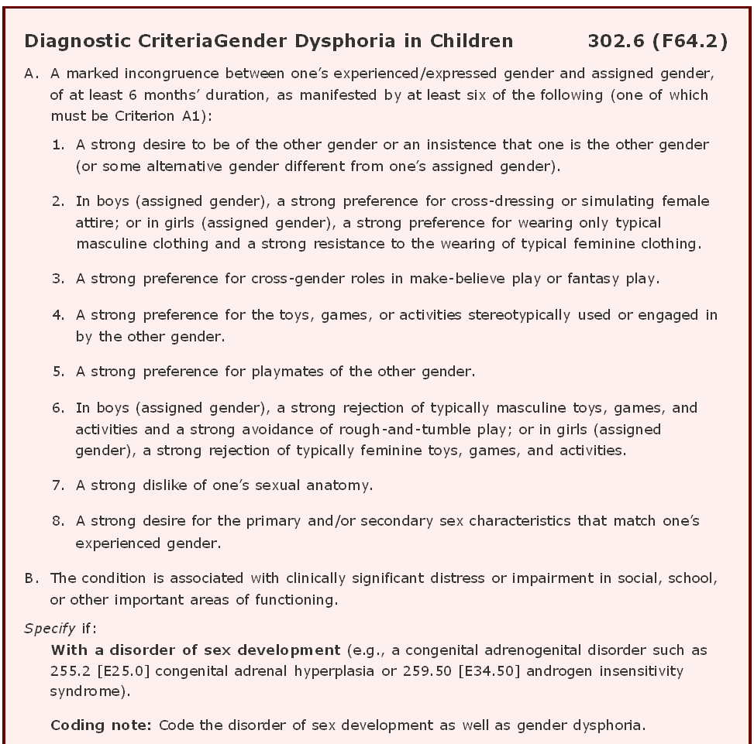
American Psychiatric Association (2013). Diagnostic and statistical manual of mental disorders: DSM-5 (Washington, DC: Arlington, Va. : American Psychiatric Publishing, c2013.).

Slide 29
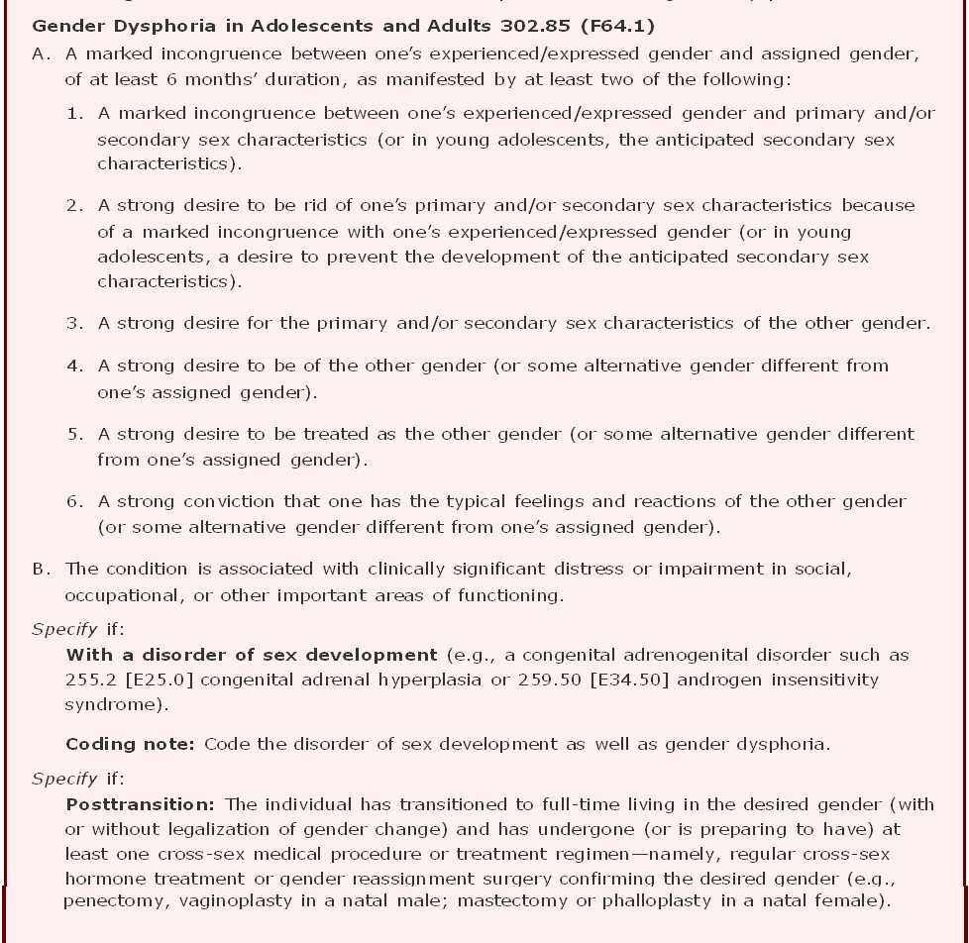
American Psychiatric Association (2013). Diagnostic and statistical manual of mental disorders: DSM-5 (Washington, DC: Arlington, Va. : American Psychiatric Publishing, c2013.).
Notes:
This condition used to be know as gender identity disorder but the new terminology is gender dysphoria. It was felt that this term more accurately reflects the distress that may accompany the mismatch of the persons assigned gender and their desired gender. This mismatch is a core feature of the diagnosis. At this point in time it is a psychiatric diagnosis and the criteria for diagnosis are laid out in the DSM – 5, a manual that classifies mental disorders and sets out criteria to reliably diagnose these disorders.
So, mental health providers who have specific training in behaviour and counselling can make the diagnosis of gender dysphoria

